Slide 1
Oral Presentation 1
Liao Wenjun (A0217795N)
18/10/23

Slide 2
Table of Content
Project Outline
Literature Review
Project Progression -What has been done -What I have done
Code Examples
Future Plan

Slide 3


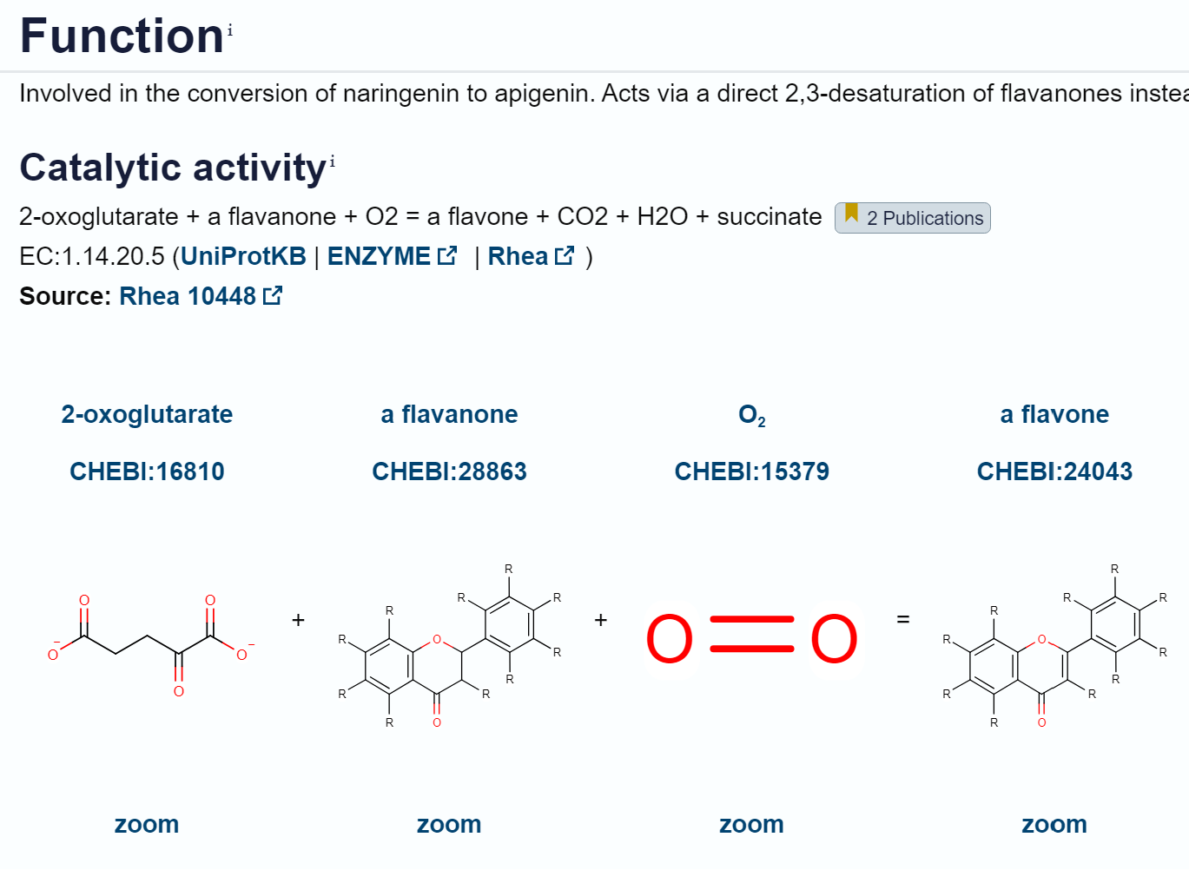

Project Outline
Title: 'Machine learning for Biodesign of engineered biological systems'
Concept: Experiments were conducted to record the fluorescence activity of randomly mutated Flavone Synthase enzymes and their corresponding DNA sequences.
Goal: Utilise Machine Learning to identify the most productive enzyme variants, ultimately determining the efficacy of specific mutations.
Notes:
The title of my project is Machine Learning for Biodesign of engineered biological systems.
We are studying an enzyme called Flavone Synthase and experiments were conducted to record the Fluorescence activity of the randomly mutated enzyme and their corresponding DNA sequences.
It catalyses the conversion of naringenin, which is mainly found in citrus fruits, to apigenin, which has many medical functions.
The goal is to

Slide 4

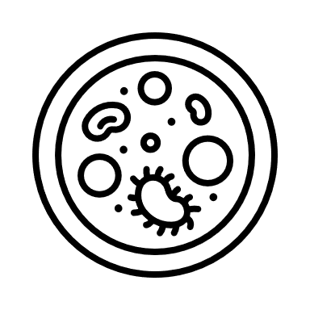


Literature Reviews
Central Dogma of Molecular Biology
Enzyme Engineering
Machine Learning
Notes:
To familiarise myself with the theoretical aspects at the start of the project, I did lit review on these topics.
In the sphere of Biodesign, understanding the DNA sequence, a blueprint that dictates the structure and function of proteins, is important. Mutations in this sequence can intricately alter the active sites of enzymes, where biochemical reactions occur. As DNA codes for amino acids, the building blocks of proteins, even a subtle change of one DNA base can code for a different amino acid and leads to significant variations in protein structure.
These structural nuances directly influence enzyme efficacy. This lead me to read up more about Enzyme Engineering, where other researchers tried various methods to improve the efficiency of enzymes.
All in all, it is crucial to decipher the complex relationship between DNA mutations, protein structures, and functional outcomes.
And in depth reading on Machine Learning was required. More will be elaborated later as I present the project progression.

Slide 5
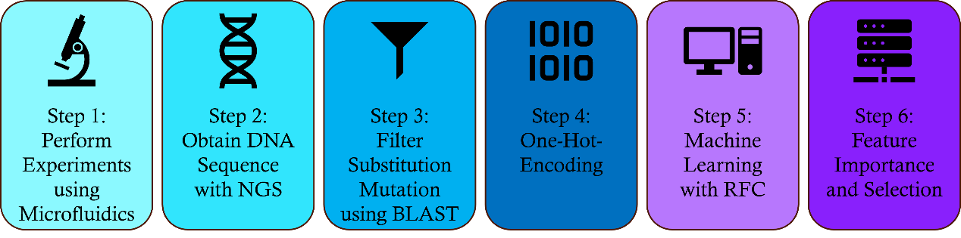
Project Progression
Experiment: - Microfluidics
Notes:
When I took on this project, experiments on the enzyme was already done and masters student Sangeetha did an extensive work on machine learning portion as well.
Firstly, the Millions of random mutagenesis experiments were conducted using microfluidics. These mutants underwent rigorous high throughput screening for fluorescence activity, classifying them into three performance categories: High, Medium, and Low.

Slide 6
Project Progression
Experiment: - Microfluidics - Next Generation Sequencing
Notes:
The samples from the 3 categories were DNA sequences were subjected to Next Generation Sequencing (NGS) to identify the sequences and stored in our database.

Slide 7
Project Progression
Experiment: - Microfluidics - Next Generation Sequencing
Machine Learning: - 1.3 million substitution mutations filtered using BLAST
Notes:
Considering the diversity of mutations arising from random mutagenesis, we focused solely on substitution mutations. Through the application of the Basic Local Alignment Search Tool (BLAST) alignment, we compared the mutant sequences with the wild type sequence, extracting only those sequences displaying substitution mutations. This curated dataset formed the basis for our Machine Learning (ML) analysis.

Slide 8
Project Progression
Experiment: - Microfluidics - Next Generation Sequencing
Machine Learning: - 1.3 million substitution mutations filtered using BLAST - One Hot Encoding of DNA sequence
Notes:
ML is a powerful statistical tool that primarily relies on numerical patterns and statistical properties within data to predict unseen patterns [5]. The DNA sequences we have obtained are represented by alphabetic characters, A, T, C, G, necessitating transformation into numerical data suitable for ML algorithms. To achieve this, we employed the One Hot Encoding (OHE) technique using the Python 'get_dummies' function. More will be explained ltr as I go through the code.

Slide 9
Project Progression
Experiment: - Microfluidics - Next Generation Sequencing
Machine Learning: - 1.3 million substitution mutations filtered using BLAST - One Hot Encoding of DNA sequence - Random Forest Classification
Notes:
Sangeetha performed multiple experiments using many Classification models and RFC yielded the best results
RFC is an ensemble learning method that combines the predictions of multiple decision trees to improve accuracy and robustness. It constructs a multitude of decision trees during training and outputs the mode of the classes (classification) or the average prediction (regression) of the individual trees.

Slide 10
Machine Learning
3 Classes: High, Medium, Low
400,000 sequences each
70% Training set, 30% Test set
Notes:
For the ML model, 400,000 sequences from each class, High, Medium, and Low. A total of 1.2million datasets of 500 bases were used. The sample was then split into 70 percent for training and 30 percent for testing. In our case, the X input would be the OHE bases and the Y input would be the class associated with that mutant, with High being 0, Medium being 1, and Low being 2. After obtaining the train and test sets, the data is ready to be trained under a model.

Slide 11
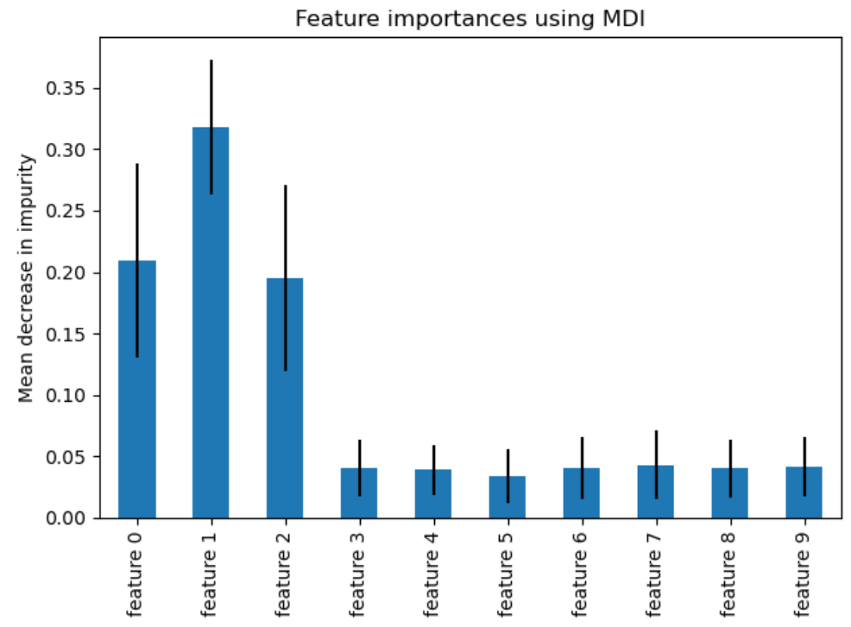
Project Progression
Feature Importance
Feature Selection
Notes:
Here is the project progression on my part after learning about the project and what Sangeetha has done.
From the one hot encoding, a total of 2212 features were used in the ML. To improve the model performance and reduce computational effort and time, feature importance and selection were explored. Feature importance selects the most relevant features that separate each class. In the graph shown here is an example of feature importance where each feature has a corresponding value assigned by the model.
In datasets with an abundant of features, not all features contribute equally to the model’s performance. Feature selection helps in reducing the dimensionality of the data and makes the model simpler, easier to interpret and less prone to overfitting

Slide 12
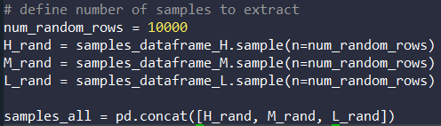
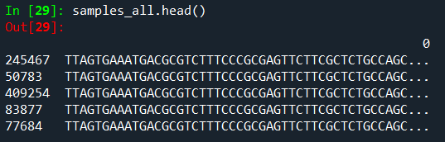
Code example (Sample extraction)
1. Extracted 30,000 samples
2. How samples_all looks like -left column due to random extraction
Notes:
I will now show you an exemplary sample from the full dataset.
Firstly, we extracted 10,000 samples from each class randomly and compile them

Slide 13
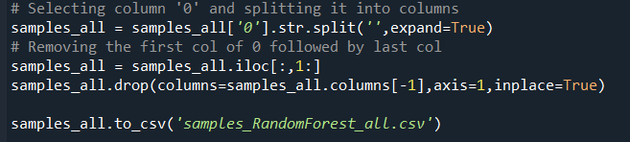
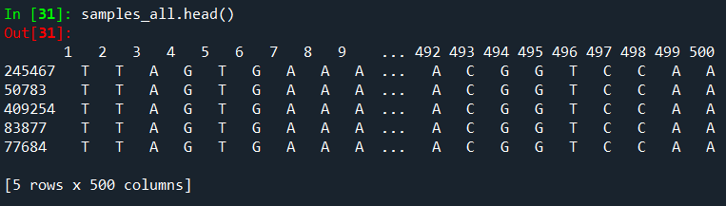
Code example (Pre-processing)
3. Separating each rows into 500 bases
4. Removing unnecessary columns
Notes:
Next, we have to perform some processing on the data by changing each row into 500 columns instead of just 1 column with 500 bases.

Slide 14
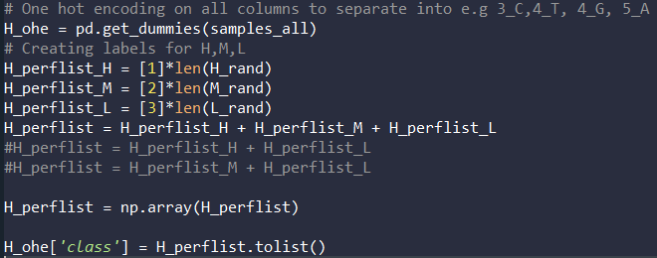
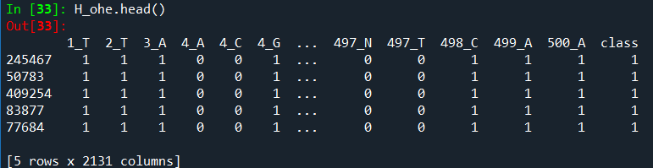
Code example (One-Hot-Encoding)
5. get_dummies does One Hot Encoding
6. Create a column: ‘class’ to distinguish H,M,L
Notes:
As mentioned earlier, we have to convert the dna sequence into the binary OHE sequence and add a column of class at the end of it.
Here is an example, where there are mutations on the 4th base, there will be 2 columns starting with 4, followed by the base, A,T,C or G
In this process, DNA bases were converted into column headings, each representing a specific position. If a position has multiple mutants, column headings will include the position and the mutant base (e.g., 1_A, 2_C, 2_T). For a given mutant sequence, a binary code of 1 was assigned to the corresponding column if the base was present, and 0 if absent.

Slide 15
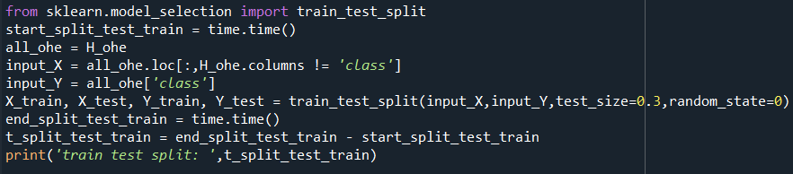
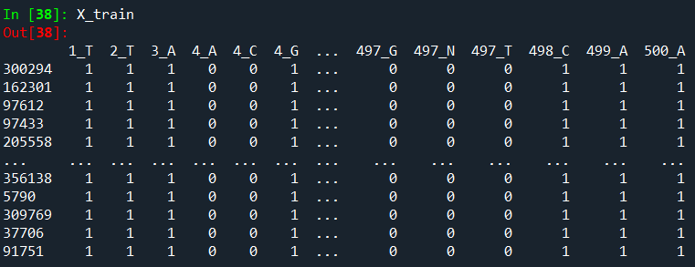
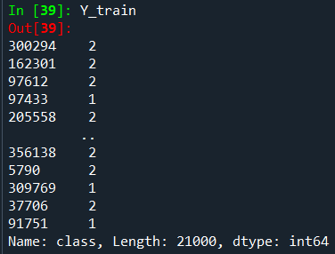
Code example (Model Building)
7. X input: OHE Bases
8. Y input: Class
9. Split train and test set into 70/30
Notes:
Now that we have the inputs, X and Y as the OHE bases and the Class respectively, we can build the model by splitting into train and test sets.

Slide 16

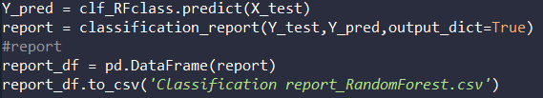
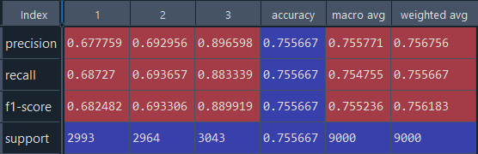
Code example (Results)
10. Input model and fit in inputs
11. Prediction results and Classification report generation
Precision: Measures how often a machine learning model correctly predicts the positive class.
Recall: True Positive Rate
F1-score: Combination of Precision and Recall to measure a Model’s accuracy
Support: The number of actual occurrences of the class in the specified dataset
Notes:
After training the model, it can be used on the test set and here are the results.
In machine learning, precision, recall, and F1 score are important evaluation metrics used to assess the performance of classification models. Precision is the ratio of correctly predicted positive observations to the total predicted positives. Recall, or true positive rate, is the ratio of correctly predicted positive observations to all actual positives. The F1 score ranges from 0 to 1, where 1 indicates a perfect balance between precision and recall. It penalizes models that have imbalances in precision and recall, offering a single metric to evaluate a model's performance, hence, we will be comparing the F1-score.
The micro average precision is the sum of all true positives divided by the sum of all true positives and false positives and it is represented by accuracy in the table
Macro average is the mean of these 3 values in the column and Weighted avg includes the number in the support.

Slide 17
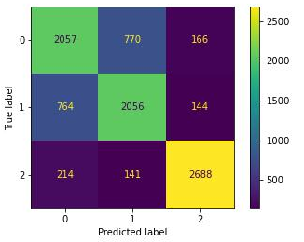
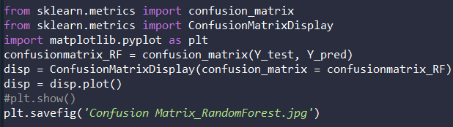
Code example (Results)
12. Confusion matrix
- Low, 2, performed best
- High and Medium, 0 and 1 not good enough
Notes:
A confusion matrix was obtained as well so it can be seen clearly how many samples were true to their predictions.

Slide 18

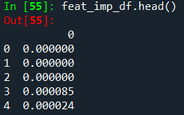
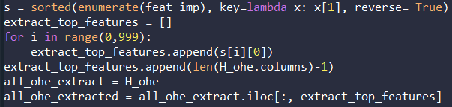
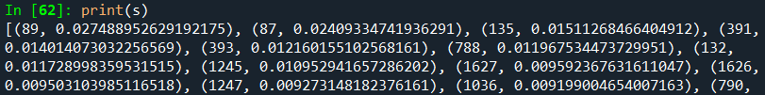
Code example (Feature Importance and Selection)
Notes:
Here is how feature importance and selection was performed.
First, we just need to use a feature importance function to extract out the value of importance for each feature, followed by sorting them from high to low. After which, we can extract the top n number of features, in this case 1000, and train a model using just 1000 features.
The sorted feature importance looks like this, where the position is shown with the value.

Slide 19
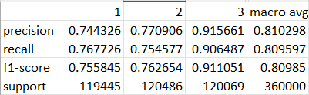
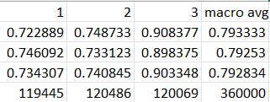
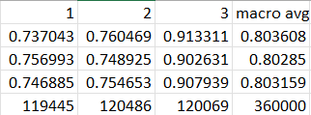
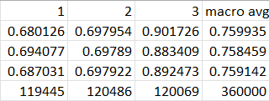
Results (Full dataset)
Without Feature Selection
With Feature Selection of 1000
With Feature Selection of 1500
With Feature Selection of 500
Notes:
The results were obtained after feature selection. And I will now present the results from the full dataset of 1.2 million mutants that I ran on the school’s high performing computer. I performed feature selections of 1500, 1000, and 500 for comparison with without feature selection.
For simplicity, we will just focus on the F1-score. It can be seen that without feature selection, the F1-score is 0.809 (click) and slowly decreases to 0.803(click) in 1500 features selection followed by 0.792 (click) and 0.759(click) in 1000 and 500 respectively.
The small decrease in the score is expected as some features were lost, but the gain in computational time and effort outweighs this small loss of 3 decimal places. Only when there is 500 features will there be a huge loss in the F1 score.
With only a drop in 0.017 from without feature selection to 1000 features selected, it is safe to use the model trained from 1000 features selected.

Slide 20
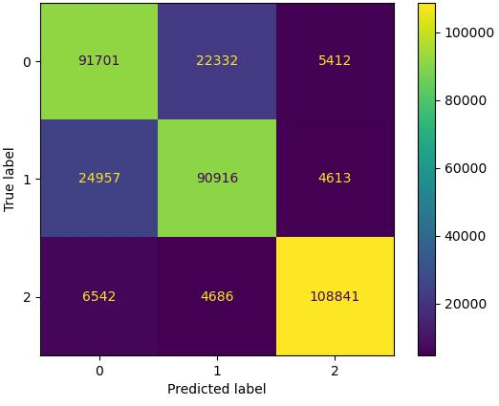

Results (Full dataset)
Without Feature Selection
With Feature Selection of 1000
Notes:
In the confusion matrix, the expected profile is seen in accordance to the results shown in the previous slide, whereby the predicted label for Class 2, which is the Low class, is very good since they correspond with the true label. Whereas the prediction for class 0 and 1, which stands for High and Medium efficacy, performed less ideally than the low class.

Slide 21

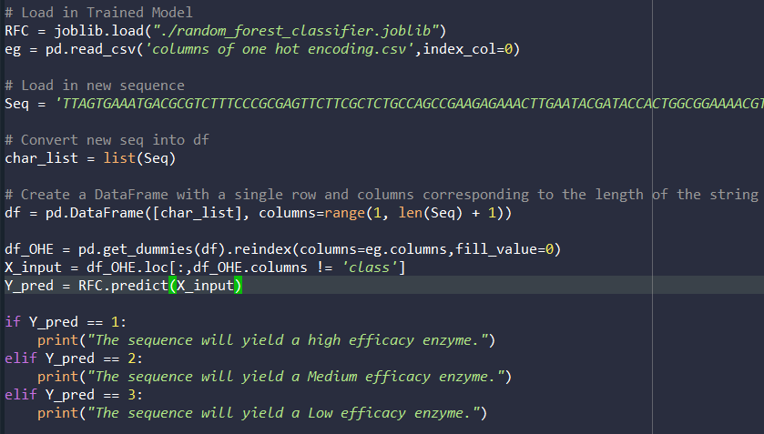

Prediction
From trained model
Prediction Code
Obtain OHE features so that the trained model can compare the same get_dummies columns
- 0 is filled in to the columns that the new sequence does not have
Notes:
To use the trained model, I wrote another code that imports the model to predict a new unseen sequence. This simulates the goal of our project whereby we want to test a new DNA sequence for its enzyme efficacy without going through the troubles of real life experiments.
The code works like this. We simply extract the trained model along with 2 rows of One hot encoded data.
We need these 2 rows because we want to convert the new DNA seq input into the same types of features that was used to train the model to ensure a fair comparison.
Similarly, the get-dummies function is used and columns that does not correspond to the new seq will have the binary code of 0.

Slide 22
Future Plan
More experimental data
Deep Leaning
Notes:
With a F-score of 0.79, the model is not good enough. One possible reason could be that the amount of training data is not enough. With 500 bases and the possible mutation of 4 nucleotide each base, a total of 500⁴ mutants could be obtained. However, we only have 1.2 million of experimental data. With more data, we can successfully obtain higher accuracies since the model can be identify more prominent features.
Deep learning (DL) can be explored for this project. Deep learning models, particularly recurrent neural networks (RNNs) or convolutional neural networks (CNNs) specialized for sequential data, can learn intricate patterns and representations from DNA sequences. A similar approach to ML using OHE can be used since DL requires numerical input as well.

Slide 23
Future Plan
Month | Aug |  | Sep |  |  |  | Oct |  |  |  | Nov |  | Nov | Nov |  |  |  |  | Dec | Dec |  |  |  |  | Jan | Jan |  |  |  |  |  | FEB |  |  |  | MAR |  |  |  | APR |  |  |  |  | MAY
Week | 2 | 3 | 4 | 5 | 6 | RW | 7 | 8 | 9 | 10 | 11 |  | 11 | 12 | 13 | 13 | 14 | 15 | 16 | 16 | 17 | V1 | V2 | V3 | V4 | V5 | 1 | 2 |  | 3 |  | 4 | 5 | 6 | RW | 7 | 8 | 9 | 10 | 11 | 12 |  | 13 |  | 17 |  | 19
Familiarize
Feature Selection
Hyper- parameter tuning
Other Classification Model
Cross fold validation
Deep learning
Predictive Capability
Progress Report 1
Preliminary Oral 1
Progress Report 2
Preliminary Oral 2
FYP work end
Thesis Submission
Final Submission
Notes:
With a F-score of 0.79, the model is not good enough. One possible reason could be that the amount of training data is not enough. With 500 bases and the possible mutation of 4 nucleotide each base, a total of 500⁴ mutants could be obtained. However, we only have 1.2 million of experimental data. With more data, we can successfully obtain higher accuracies since the model can be identify more prominent features.
Deep learning (DL) can be explored for this project. Deep learning models, particularly recurrent neural networks (RNNs) or convolutional neural networks (CNNs) specialized for sequential data, can learn intricate patterns and representations from DNA sequences. A similar approach to ML using OHE can be used since DL requires numerical input as well.

Slide 24
Thank You

